Slide 1
GO Team Business Meeting #1
Miles Elementary School
9/25/25

Slide 2
Agenda

Slide 3
2021-2025 Strategic Plan

Slide 4
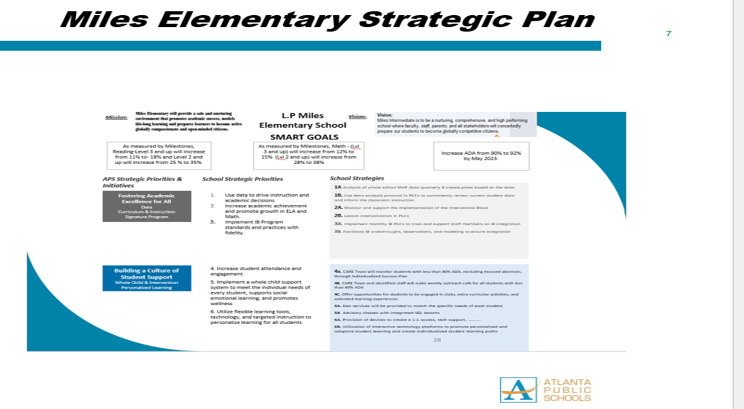

Slide 5
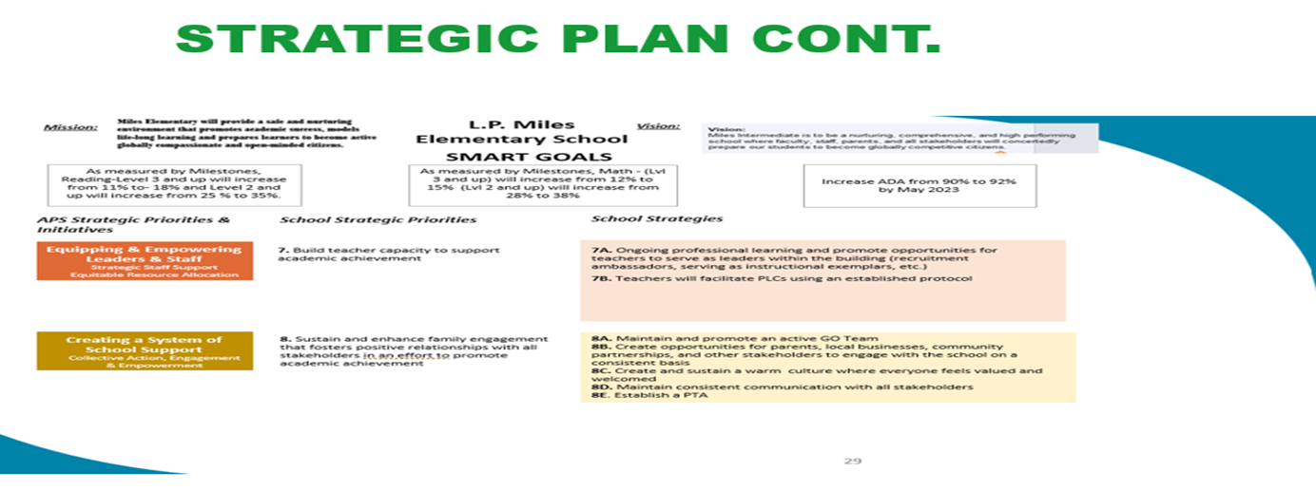

Slide 6
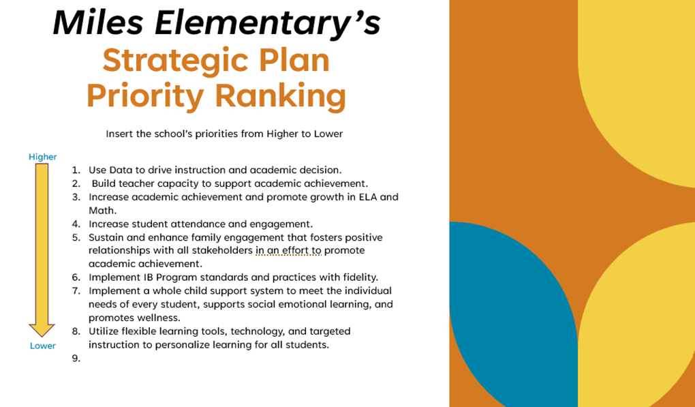
Strategic Plan
Priority Ranking
Insert the school’s priorities from Higher to Lower
Higher
Lower

Slide 7
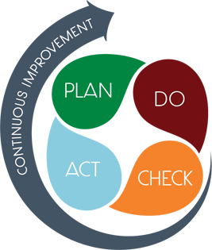
Connecting the Strategic plan & Continuous Improvement Plan
Increase academic achievement/proficiency in ELA
GMAS
Level 3 and up (proficiency and above) will increase from 16% to 21%
Strategic Plan Priority
CIP SMART Goal
Key Indicator
Increase academic achievement/proficiency in Math
Level 3 and up (proficiency and above) will increase from 11% to 16%
GMAS
Implement Whole Child Support System
Increase ADA from 86.9% to 91.9%
EOY Average Daily Attendance (ADA)

Slide 8
Data Discussion

Slide 9
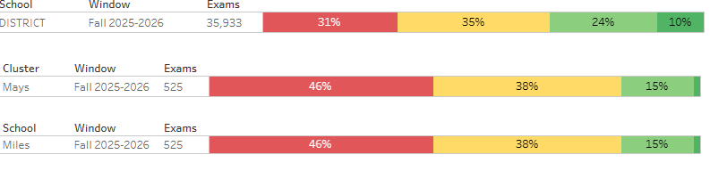
MAP Results

Slide 10
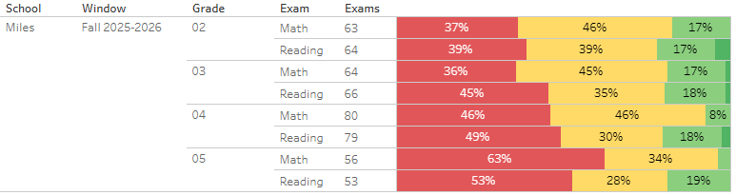
MAP Results

Slide 11
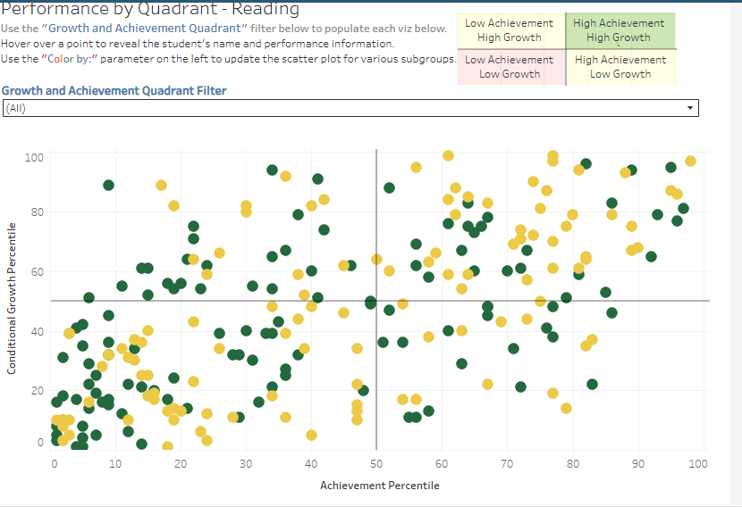
MAP Results – Growth Quadrant

Slide 12
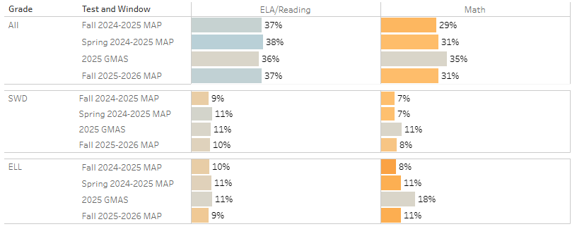
MAP Results – SubGroups

Slide 13

Mathematics
Are we meeting our goals?
Grade | Level 3 & Above (22%)
3rd | 18%
4th | 8%
5th | 3%
School Avg. | 13%

Slide 14
English Language Arts (ELA)
Are we meeting our goals?
Grade | Level 3 & Above (25%)
3rd | 19%
4th | 20%
5th | 19%
School Avg. | 23%

Slide 15
GO Team Discussion: Data Protocol
What do you notice?
What are your wonderings?
Based on our school’s trend data from MAP assessments and end-of-year test assessments, which student sub-groups and grade levels showed the most significant gaps or unexpected trends?
Based on our school’s trend data from MAP assessments, Milestones and other indicators, are there specific trends that require more focused attention?
What additional questions do you have?

Slide 16
Glows & Grows
Glows
Grows
Overall MAP ELA is close to EOY goals
3rd grade MAP Math is close to meeting EOY goal
SWD is hitting EOY target for ELA
Overall MAP Math is far from EOY goals
MAP Math is far from EOY Goals
ELL subgroup is the furthest away from hitting EOY.
SWD is not hitting EOY Target
Overall MAP Data is lower from last year
are we on target to successfully ACCOMPLISH our priorities?
IMPACT

Slide 17
Timeline for GO Teams
You are HERE
Fall 2021
GO Team Developed 2021-2025 Strategic Plan
1
Summer
School Leadership completed Needs Assessment and defined overarching needs
2
August
School Leadership completed Continuous Improvement Plan
3
Sept. – Dec.
GO Team reviews progress on current strategic plan.
GO Team develops 2025-2030 School Strategic Plan
4
Before Winter Break
GO Team will take action (vote) on the rank of the strategic plan priorities for SY26-27 in preparation for budget discussions.
5

Slide 18
Questions?

Slide 19
Uniform Discussion

Slide 20
Discussion: Optional School Uniform

Slide 21



Optional School Uniform
In the 2023-2024 school year, the APS Board of Education updated the district’s dress code policy. As part of the update, starting with the 2025-2026 school year if a school wishes to maintain or explore implementing an optional school uniform, it must go through an engagement process and have a vote as outlined below:
Elementary
Middle
High
A school uniform is adopted upon the agreement of the principal and a majority vote of the School Governance Team (GO Team).
School uniforms are adopted upon the agreement of the principal, GO Team and the elected student government. If the school does not have an elected student government, then a majority vote must be secured from the student body to adopt a school uniform.
School uniforms are adopted upon the agreement of the principal, GO Team and the elected student government. If the school does not have an elected student government, then a majority vote must be secured from the student body to adopt a school uniform.
If your school currently has a school uniform and wishes to continue it, you must go through this process!

Slide 22
ABOE Policy JCDB Student Dress Code (Last Revised, 06/03/2024)
http://tinyAPS.com/?APSDressCodePolicy
Requirements
Restrictions
A top of non-see through fabric
A bottom of non-see through fabric
Shoes
Undergarments that are not visible
No words or symbols that are gang-related, sexually suggestive, obscene or promote illegal behavior
Nothing associated with alcohol, illegal drugs or tobacco
No flip-flops, athletic slides or footwear that doesn’t support the front and back of the foot

Slide 23
School-specific Dress Codes
We have one districtwide student dress code adopted
by the Atlanta Board of Education.
School-specific dress codes may not contradict Board policy.
Examples of problematic school specific dress-code provisions
“dress in good taste”
“no baggy pants”
“no short shorts or skirts”
“no tight/revealing clothing”
“no ‘extreme’ hairstyles or colors”
“all shirts must be tucked in
“hair should be clean and neatly groomed”
“no shirts which expose cleavage”
“students dressed in uniform are better perceived by teachers and peers”
“no activewear”
“no sweatpants”
“no spaghetti straps”
“no tube tops”
“no dresses”
“no leggings”
“no joggers”
“no Crocs”
“no hoodies/hooded jackets”

Slide 24
School Uniforms
Schools may choose to adopt an optional school uniform.
Effective immediately, at no time will students have their instructional time interrupted or be barred from school or class for declining to wear the optional school uniform.

Slide 25
Are We Interested in Establishing an optional school uniform?
The GO Team needs to vote on maintaining or exploring implementing an optional school uniform.
After the motion and a second, the GO Team may have additional discussion. Once discussion is concluded, the GO Team will vote.
If the GO Team votes to move forward, then the team should proceed to discuss the School Uniform Advisory Committee.
Take Action

Slide 26
DISCUSSION
Only needed if the GO Team voted YES to maintaining or exploring establishing an optional school uniform.
The GO Team will now discuss if they wish to move forward with establishing a School Uniform Advisory Committee.
The School Uniform Advisory Committee will be responsible for:
Develop a stakeholder engagement plan to receive feedback on implementing a uniform and its components, if adopted. Must include a minimum 20-day public comment period on any proposed uniform
Recommending the optional school uniform components.
Establishing the student voting timeline and process (if necessary).
Determine the length of time the uniform will be in use before reconsideration
Developing a communication plan to inform the school community about the optional school uniform, if the uniform is adopted
Other objectives as defined by the GO Team.

Slide 27
Committee members
Only needed if the GO Team voted YES to maintaining or exploring establishing an optional school uniform.
The GO Team will also need to determine who will be on the committee:
The GO Team Chair will name the Committee Chair.
No more than 2 additional GO Team members may be on the committee (a maximum of 3 GO Team Members).
Committee must have at least 3 students as outlined below:
Other committee members may be added, as determined by the GO Team.
Elementary
Middle
High
Elementary School with Ambassadors Recommend inclusion of at least 3 student ambassadors
Elementary School without Ambassadors
Recommend inclusion of at least 3 students selected by the principal with GO Team input
Middle School with Student Ambassadors
At least 3 student ambassadors
Middle School without Student Ambassadors
At least 3 students selected by the principal with GO Team input
High School with Elected Student Government
At least 3 students as selected by the SGA
High School without Elected Student Government
At least 3 students as selected by the principal with GO Team input

Slide 28
Establish the Committee
Only needed if the GO Team voted YES to maintaining or exploring establishing an optional school uniform.
The GO Team needs to TAKE ACTION (vote) on establishing its School Uniform Advisory Committee based on the previous discussion.
After the motion and a second, the GO Team may have additional discussion.
Once discussion is concluded, the GO Team will vote.
If the GO Team votes in the affirmative (yes) for moving forward, then the Chair will need to fill out a committee resolution form (see example on next slide) and send to the GO Team Office.
Take Action

Slide 29
Blank Committee Resolution

Slide 30
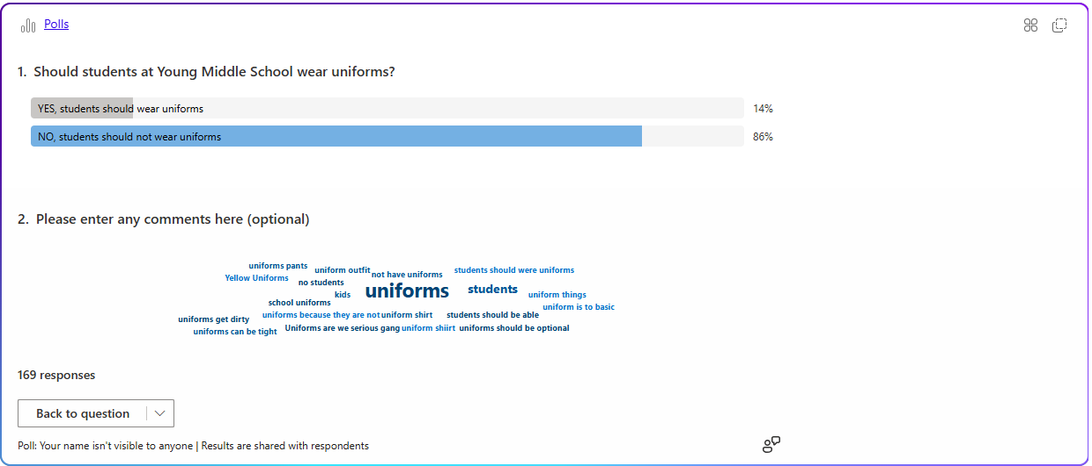
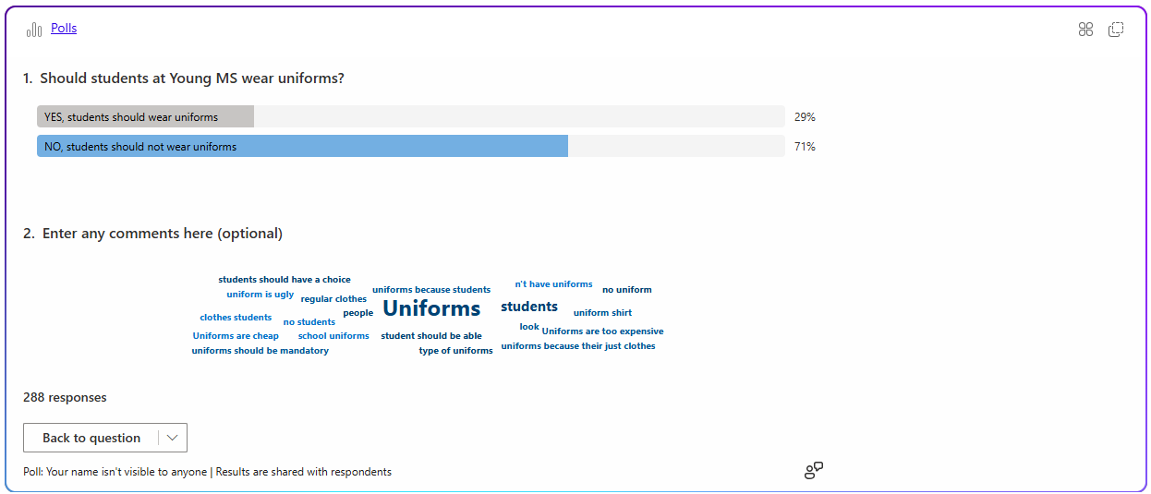
ABOE Policy JCDB Student Dress Code
Uniform Vote
457 Responses
76% (349) = NO
24% (108) = YES

Slide 31
Are We Interested in Establishing an optional school uniform?
If we do, we need to re-engage the student body and ultimately facilitate a final vote by the December GO Team meeting
The vote of student body must match the vote of the GO team (both votes must be “Yes”) to reinstate the optional uniform policy in January 2026
If both votes are not yes, we could start the process again in January 2026 in order to explore the uniform option for the 2026-27 SY

Slide 32
Principal’s Report

Slide 33



Miles Elementary
LEVELING AND
FY26 BUDGET ADJUSTMENT
Template Last Revised: 9/4/2025

Slide 34

Enrollment
Projected Enrollment | 469
15-Day Count(08.22.25) Enrollment | 387
Difference | -82
Leveling
Leveling is the process the District uses to adjust school budget allocations to match student enrollment.
Budget Adjustment | $-488,884 (due to change at base weight)
*The budget adjustment reflects the impact of the following: enrollment changes, FY25 reserve, adjustments to Title I, Family Engagement and School Improvement Allocations, Security Grants and FY24 carryover funds
Notes:
Principals: Based on your15-Day count, please give your GO Team an overview of your projected vs. 8/22 enrolled numbers as well as information on your FY26 budget adjustment.

Slide 35
Plan for FY26 Leveling Reserve
$131,269
Priorities | Strategies | Requests | Amount
Increase academic achievement and promote growth in core content classes | Monitor and support the implementation of core content instruction and the Intervention Block Lesson internalization in PLCs Small Group Instructional Support IB Implementation | Purchase additional instructional resources for math and assessment bank IB training for staff and IB resources/supplies | $131,269
Notes:
Review the previously discussed plan for the FY26 Leveling Reserve as discussed by the GO Team in your Feb. 2025 Budget Feedback meeting and March 2025 Approval meeting.

Slide 36
Plan for FY26 Title I Holdback
$49,275
Priorities | Strategies | Requests | Amount
Utilize flexible learning tools, technology integration, and targeted instruction to personalize learning for all students | Utilize Instructional Software to enhance core instruction and Intervention | Purchase instructional software and instructional resources/supplies | $49,275
Notes:
Review the previously discussed plan for the FY26 Title I Holdback as discussed by the GO Team in your Feb. 2025 Budget Feedback meeting and March 2025 Approval meeting.

Slide 37
Summary of Changes as a Result of FY26 Budget Adjustment
$ -488,884 = Adjustment
Personnel Changes | Non-Personnel Changes
NA – Held harmless | NA – Held harmless
 | *113,269 = reserve funds used to address the budget adjustment
Summary of Changes
Actual total adjustment = $-488.884 after utilizing the reserve funds ($113,269) and as a result of prorating the losses by 25%. Actual adjustment = $0 as a result of being held harmless.

Slide 38


APS Forward 2040:
Reshaping the Future of Education
Taskforce Meetings
May 8, 2025 - Presentation
August 5, 2025- Presentation
Upcoming Public Meetings
October 20
November 10
Virtual – at Noon
In-person at 6PM at CLL (130 Trinity Ave)
UPDATE
Comprehensive Long-Range Facilities Plan
atlantapublicschools.us/APS2040
Notes:
Next on our agenda, we’d like to welcome our representative to the Long-Range Comprehensive Facilities Master Plan Taskforce. As many of you know, this taskforce plays a key role in shaping the future of our district’s facilities — ensuring they are aligned with projected enrollment, instructional needs, safety standards, and long-term community use."
Over the summer, the taskforce has been hard at work reviewing data, exploring options, and engaging in important planning conversations. [Name of Representative] will share an update on what’s been done so far, any key decisions or recommendations that have been made, and what’s ahead — including opportunities for the public to provide input.
[Allow the FMP representative to provide an update and answers questions. After this is concluded:]
Thank you [Name of Representative].
A report will be presented to the Board at its August 11 meeting, and the options will become public the week of August 18.
There are several upcoming public meetings where you can learn more and share your thoughts. The next public meetings are scheduled for: August 25, October 20, and November 10
On each date, there will be a virtual meeting at noon and an in-person meeting at the Central Office at 6PM.
I strongly encourage you all to attend these meetings. This is a critical time for public input, and your voice is essential.

Slide 39
Principal’s
Update

Slide 40
Information about our school
Enrollment Projection for 2025-26 = 469
Current Enrollment (as of 9/25/25) = 387
K- 45
1st -59
2nd -71
3rd -69
4th -88
5th -67
Pre-K- 31
Enrollment in May, 2025= 401
Average Daily Attendance= 92.1% (APS = 93.4%)
K= 93.9
1st = 91.8
2nd = 92.2
3rd-= 91.6
4th = 91.2
5th =92.7
Suspension Rate = ..24 (down from .35 in 2024-25)

Slide 41
SAVE THE DATE
IN-PERSON
G3 Summit
Go.Grow.Govern.
Bring the full GO Team
Come ready to collaborate, contribute, and create the future!
Saturday
September 27
8:30 AM – 2:30 PM
Come learn more about:
Your school’s 2025-2030 Strategic Plan
Stakeholder Engagement
Charter System
…and much more
Atlanta College & Career Academy
1090 Windsor St SW
Notes:
Before we move on, I want to highlight an important upcoming event: the G3 Summit on Saturday, September 27 at the Atlanta College and Career Academy.
We need as many GO Team members as possible to attend — this is a critical opportunity to come together, in person, and shape the future of our schools. Strategic planning for 2025–2030 is underway, and your voices, ideas, and leadership are essential.
You’ll be learning about your school’s new strategic plan, best practices for stakeholder engagement, and how this work connects to APS Forward 2040 — plus much more.
Please save the date and plan to attend! Come ready to collaborate, contribute, and create the future together.
More information will be coming soon.

Slide 42
Questions?

